Slide 1
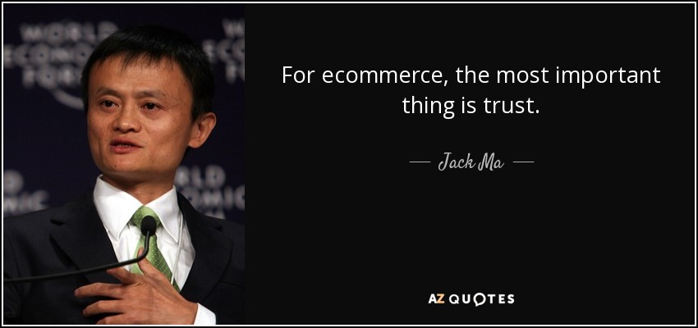
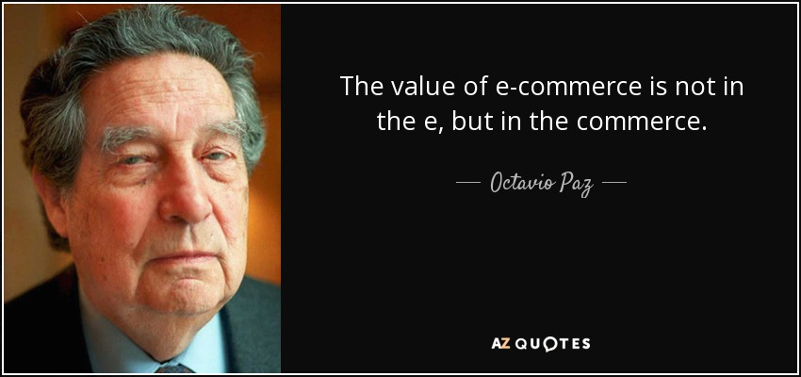
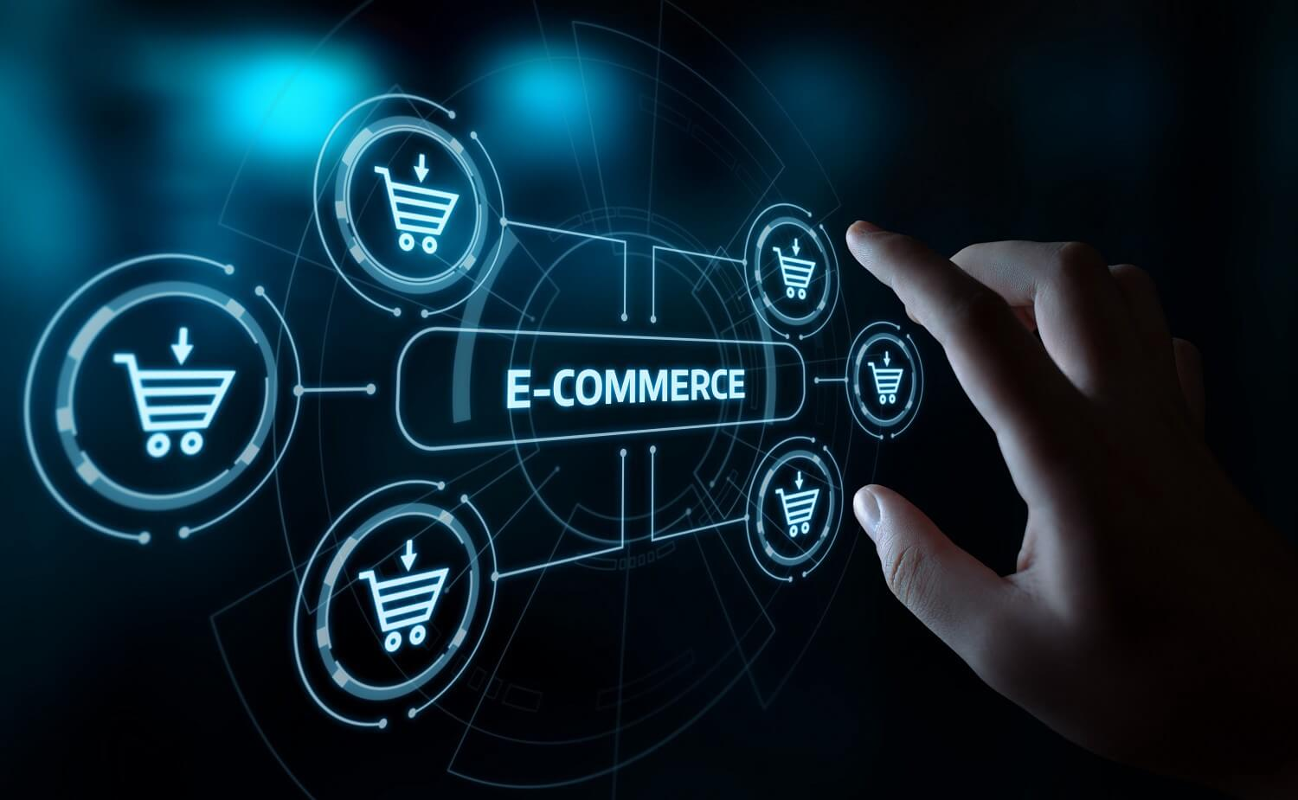
E- commerce
Electronic commerce

Slide 2
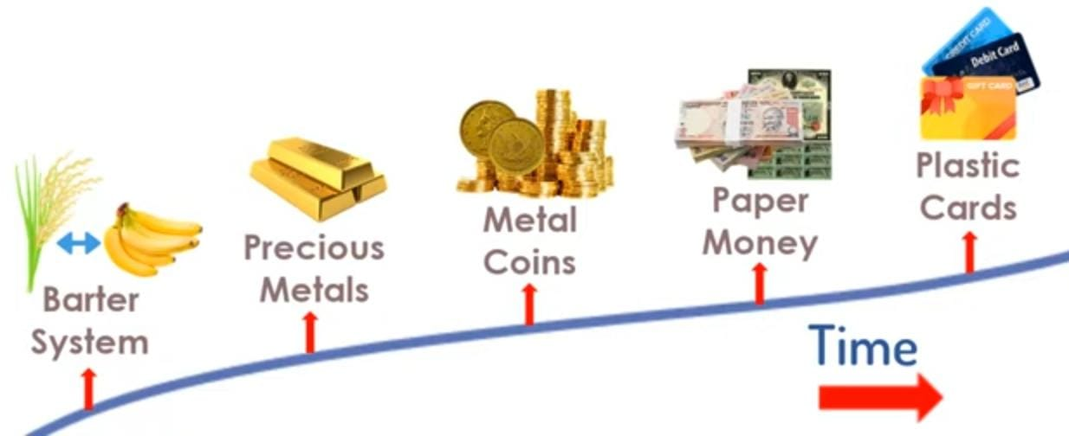
commerce
Commerce is buying and selling of goods

Slide 3
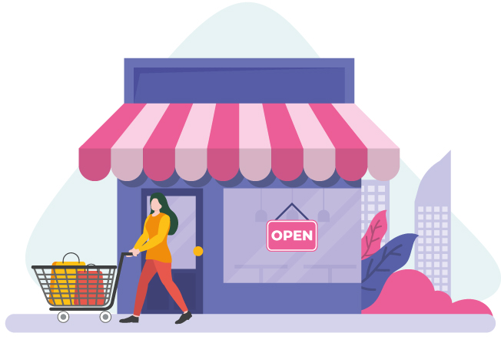
Traditional commerce
Business happens face to face
Limited to particular geographic
location.
There is personal interaction.
Delivery of goods is instantaneous
Limited to certain business hours
typically during day time.

Slide 4
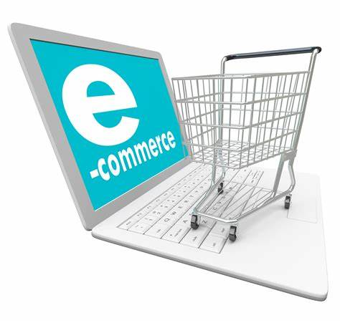
What is E-Commerce
Commonly known as Electronic-marketing.
It consists selling and buying goods and services over an electronic system such as the internet and other computer network.

Slide 5






E-commerce

Slide 6
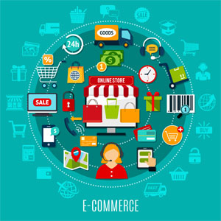
E-commerce
Sale happens online.
You can potentially sell across
the world.
There is limited personal
interaction
Delivery of goods and services might
take some time.
It is available 24/7 and can be done
day or night.

Slide 7
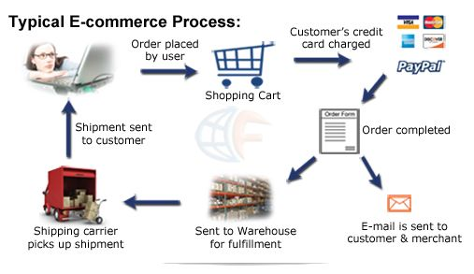

Slide 8
Traditional commerce
E-commerce
Business happens face to face
Limited to particular geographic location.
There is personal interaction.
Delivery of goods is instantaneous
Limited to certain business hours typically during day time.
Sale happens online.
You can potentially sell across
the world.
There is limited personal interaction.
Delivery of goods and services might take some time.
It is available 24/7 and can be done day or night.

Slide 9
Types of E-Commerce

Slide 10
Business - to – Business (B2B)
In this case, both the buyer and the seller are business organizations.
B2B stands for Business to Business. It consists of largest form of e-commerce. This model defines that buyer and seller are two different entities. It is similar to manufacturer issuing goods to the retailer or wholesaler.

Slide 11
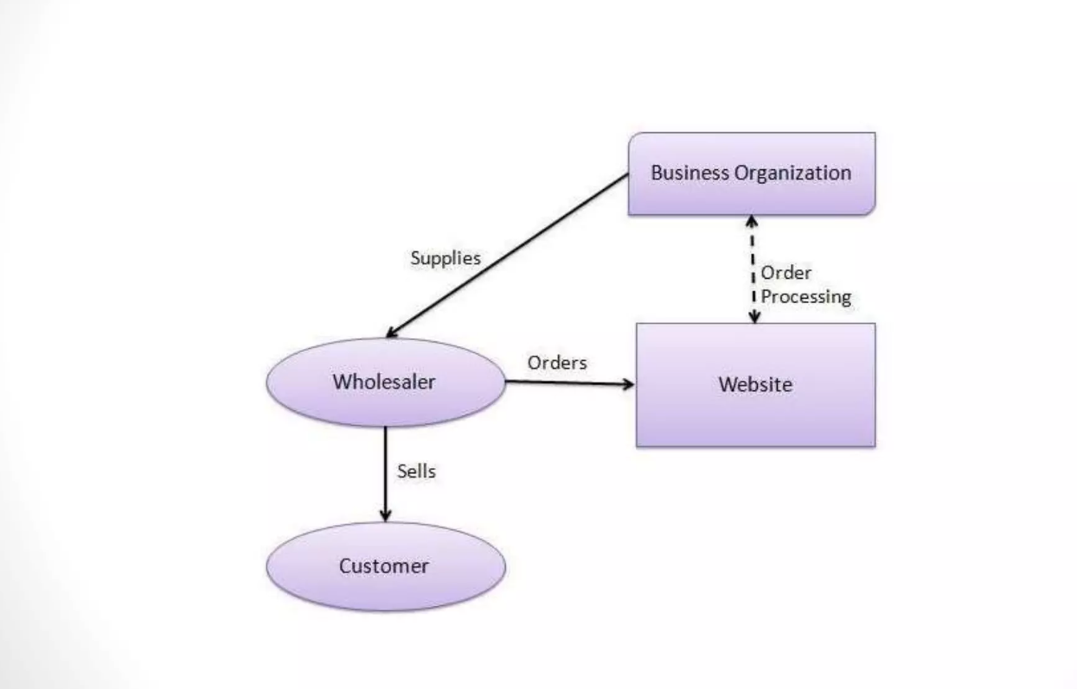

Slide 12
Business- to- consumer (B2C):
It is the model taking businesses and consumers interaction. The basic concept of this model is to sell the product online to the consumers.
B2C is the direct trade between the company and consumers. It provides direct selling through online.
For example: if you want to sell goods and services to customer so that anybody can purchase any products directly from supplier’s website.

Slide 13
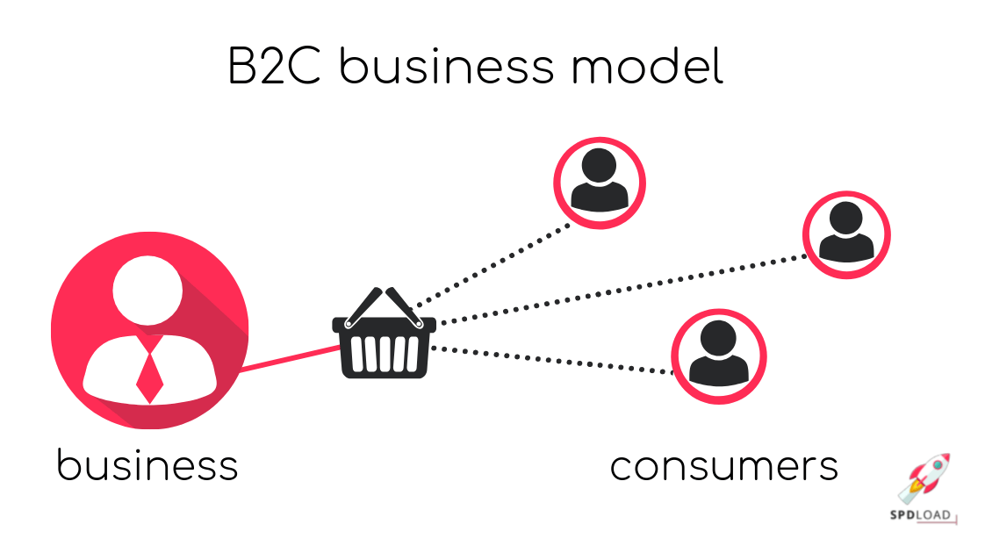
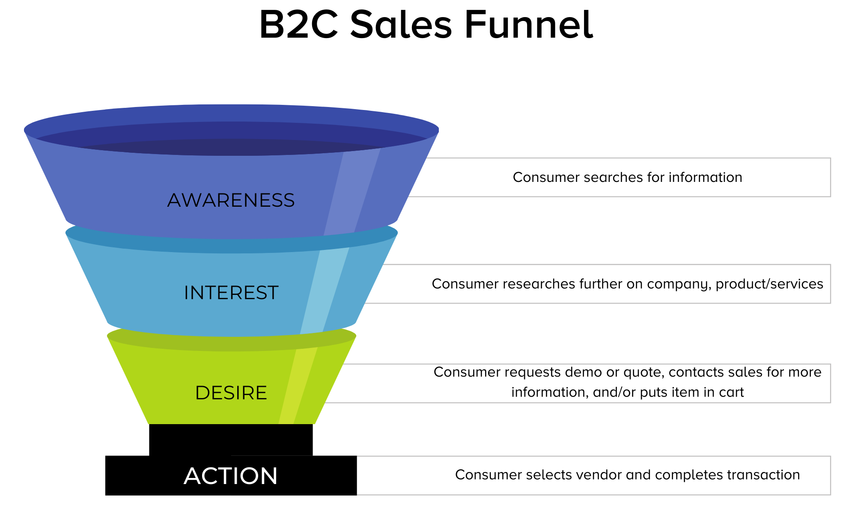

Slide 14
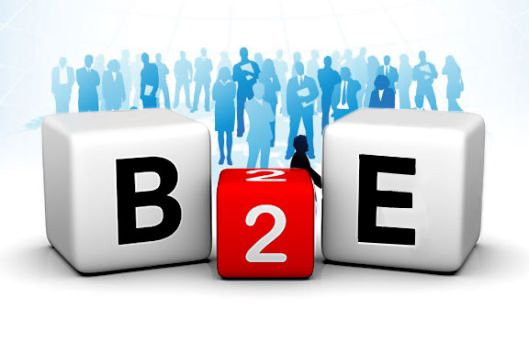
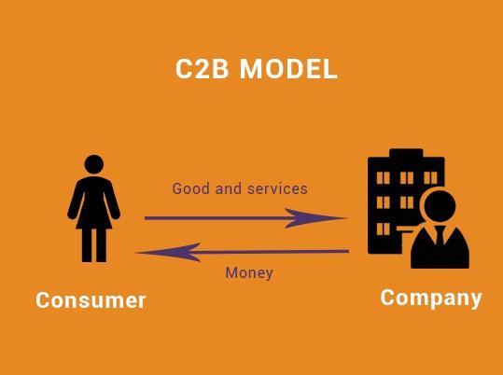
Consumer –to – Business(C2B)
The consumer-to-business (C2B) e-commerce model allows businesses and consumers to have a mutually beneficial relationship. It is the opposite of the traditional business setup: In this relationship, the consumers create value that an organization uses to engage in a business process or gain a competitive advantage

Slide 15
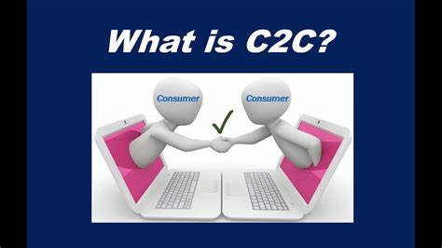
Consumer-to-consumer (C2C):
Customer to customer (C2C) is a business model whereby customers can trade with each other, typically in an online environment. EBay's auction service is a great example of where person-to-person transactions take place everyday since 1995.

Slide 16
E-Commerce:
Advantages:
Available 24/7
Provides a global reach
No need for intermediaries.
Provides user with options to compare and select best option.
Reduces paper work.
Lowers the transaction cost.

Slide 17
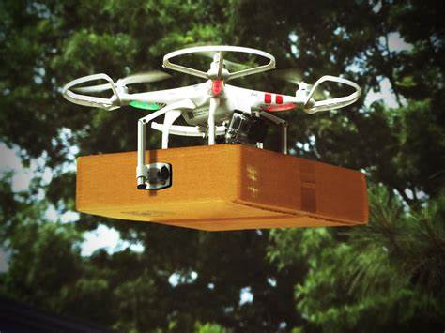
Future of E-commerce
the predicted global retail Ecommerce market revenue will be $5.7 trillion in 2022. This amount will increase by 56% over the next years, attaining about $8.1 trillion by 2026.
Drones for Delivery

Slide 18
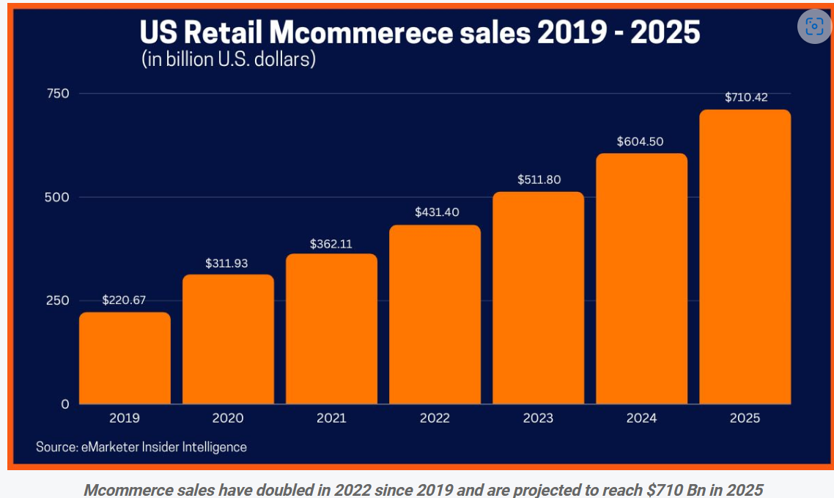
Future of E-Commerce
Rising mobile commerce

Slide 19

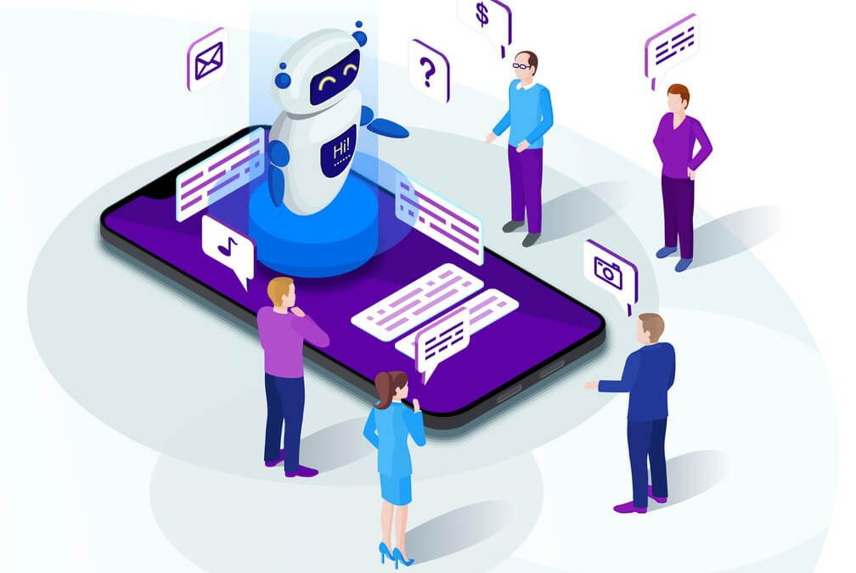
Automated service

Slide 20
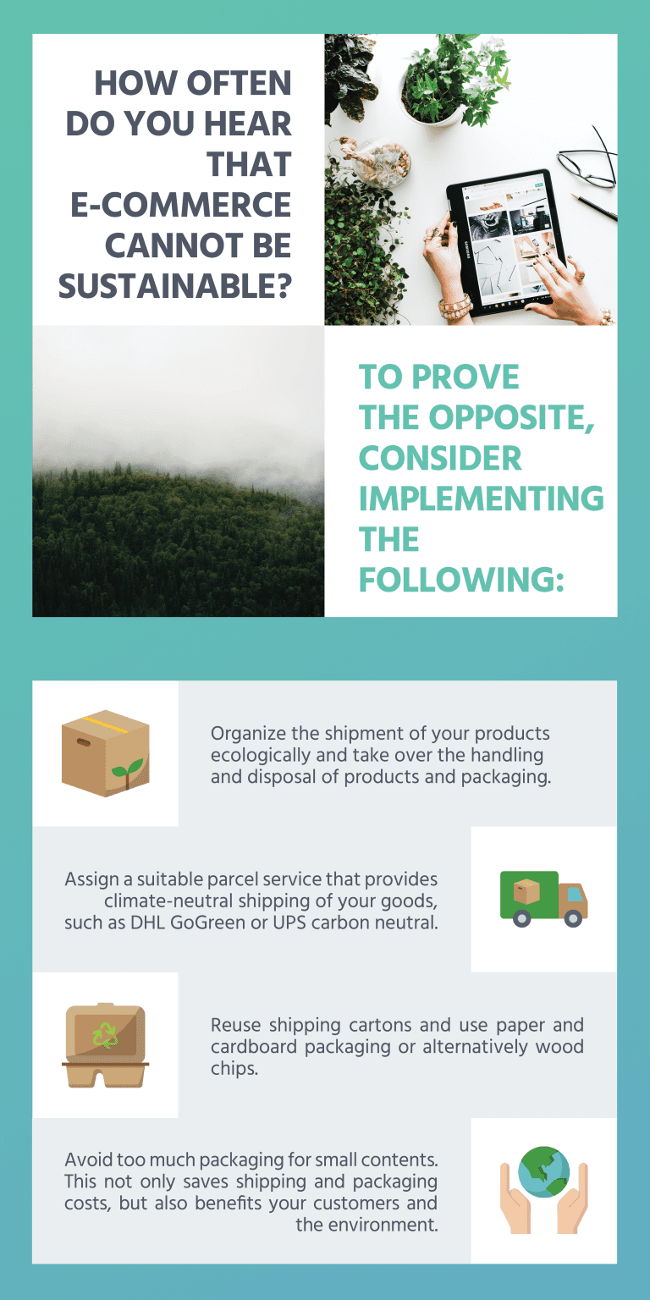
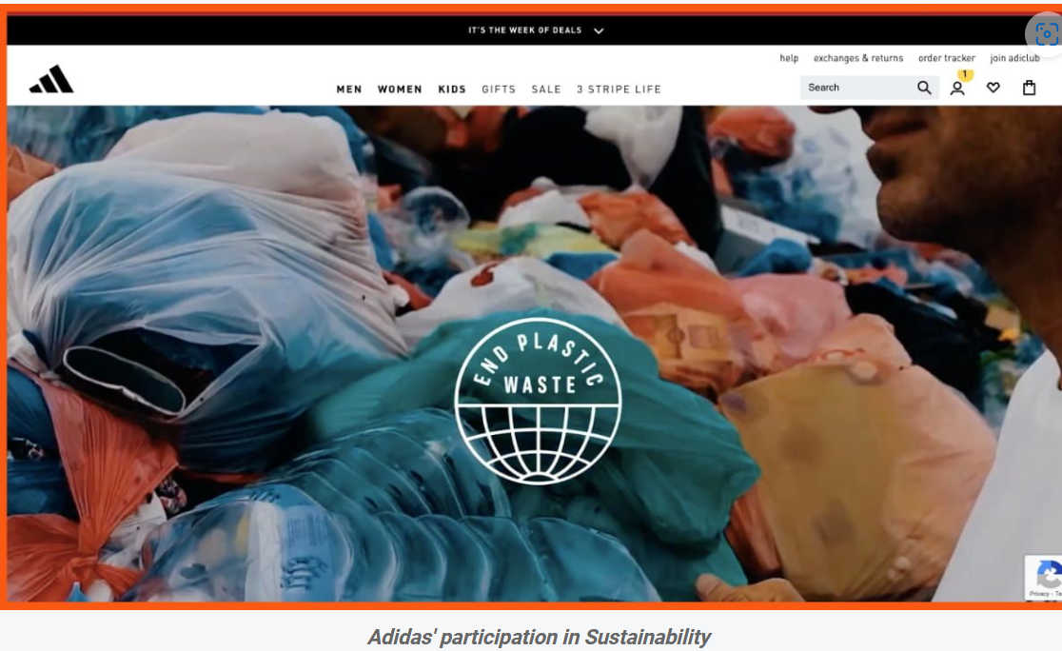
Future of E-Commerce
Social responsibility and
Sustainability

Slide 21

